Slide 1
A Brief Introduction to LaTeX for Scientific Writing
Mohammadhossein Farzanfar

Slide 2
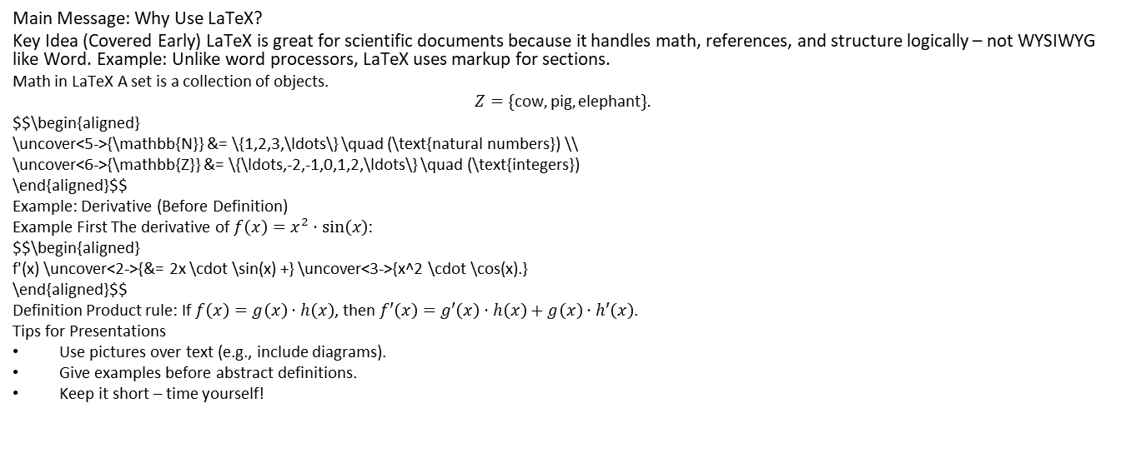
Main Message: Why Use LaTeX?
Key Idea (Covered Early) LaTeX is great for scientific documents because it handles math, references, and structure logically – not WYSIWYG like Word. Example: Unlike word processors, LaTeX uses markup for sections.
Math in LaTeX A set is a collection of objects.
$$Z=\{\text{cow},\text{pig},\text{elephant}\}.$$
$$\begin{aligned} \uncover<5->{\mathbb{N}} &= \{1,2,3,\ldots\} \quad (\text{natural numbers}) \\ \uncover<6->{\mathbb{Z}} &= \{\ldots,-2,-1,0,1,2,\ldots\} \quad (\text{integers}) \end{aligned}$$
Example: Derivative (Before Definition)
Example First The derivative of $f\left(x\right)=x^{2}⋅sin\left(x\right)$:
$$\begin{aligned} f'(x) \uncover<2->{&= 2x \cdot \sin(x) +} \uncover<3->{x^2 \cdot \cos(x).} \end{aligned}$$
Definition Product rule: If $f\left(x\right)=g\left(x\right)⋅h\left(x\right)$, then $f′\left(x\right)=g′\left(x\right)⋅h\left(x\right)+g\left(x\right)⋅h′\left(x\right)$.
Tips for Presentations
Use pictures over text (e.g., include diagrams).
Give examples before abstract definitions.
Keep it short – time yourself!

